Slide 1
Micro Phase Shifting
Mohit Gupta and Shree K. Nayar
Computer Science
Columbia University
Supported by: NSF and ONR

Slide 2
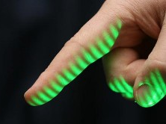

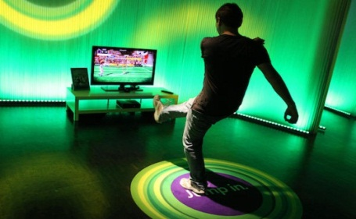
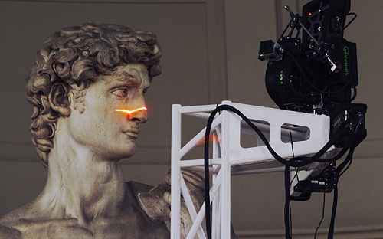
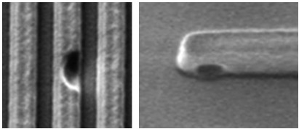
Structured Light 3D Scanning
Biometrics
Gaming
Wafer defect
Archiving Heritage
Defect Inspection
Notes:
It has now matured into something very reliable, and very accurate. In today’s world, it forms the workhorse in several industries, including manufacturing. It has been used for digital archiving, used in biometrics. Kinect, the fastest selling electronic device ever, is a structured light system.

Slide 3

Shape from Structured Light
camera
image plane
image
correspondence
scene
image plane
projector
pattern
Notes:
Explain Structured Light very briefly. You code the scene to get correspondences. This has a long history. Show single stripes, binary, phase-shifting.
One of the most popular is phase-shifting because it is fast, and it gives high, sub-pixel resolution.

Slide 4



Structured Light Coding Schemes
Ambiguity
Correspondence
Correspondence
Correspondence
Peak Location
Binary Code
Phase
radiance
radiance
radiance
time
time
time
Light Striping
Binary Codes
Phase Shifting
[Shirai and Suwa, 1971]
[Agin and Binford, 1976]
[Minou et al., 1981]
[Posdamer et al., 1982]
[Srinivasan et al., 1985]
[Wust and Capson, 1991]
Notes:
Then, talk about phase-shifting. Start this with a single point. Show how a spatially shifting sinusoid produces a temporal sinusoid. Then, say that if we look at the sinusoid at a different point, it will have the same frequency, but the phase will be shifted. By measuring this phase, we get the depth.
In conventional phase-shifting, we use a low-frequency pattern to get depths. The high-frequency patterns are used to refine the results.
Show how with high-frequency patterns, there are ambiguities since many points have the same phase.

Slide 5



Phase Shifting
Accurate but Ambiguous
Unambiguous but Noisy
ω_{max}
ω_{mean}
ω_{min}
Broad Frequency Band
amplitude
frequency (ω)
Notes:
This is different than conventional phase shifting, where the patterns have a broad band of spatial frequencies.

Slide 6

Phase Shifting: Issues
Interreflections
Defocus
camera
scene
projector
scene
P
Q
interreflections
projected image
received image
projector
Notes:
Now, let’s take the same scene and illuminate it with a limited depth of field device, such as a projector. For example this projector here. Projectors are designed to project a focused image on a single flat screen. However, if the projector focal plane is not on the scene, the image will be blurred or defocused. This is called defocused illumination.
Now these are two completely different physical effects – global illumination is an intrinsic property of the scene, and depends on material properties and scene geometry. On the other hand, defocused illumination is a property of the illumination device. So, one is a property of the scene, the other a property of illumination. Then why is it that we are interested in studying them together?

Slide 7

Phase Shifting: Issues
Interreflections
Defocus
camera
defocus blur
scene
projector
scene
P
Q
interreflections
projected image
received image
blurred
projector
Notes:
Now, let’s take the same scene and illuminate it with a limited depth of field device, such as a projector. For example this projector here. Projectors are designed to project a focused image on a single flat screen. However, if the projector focal plane is not on the scene, the image will be blurred or defocused. This is called defocused illumination.
Now these are two completely different physical effects – global illumination is an intrinsic property of the scene, and depends on material properties and scene geometry. On the other hand, defocused illumination is a property of the illumination device. So, one is a property of the scene, the other a property of illumination. Then why is it that we are interested in studying them together?

Slide 8
Phase Shifting and Interreflections
camera
Direct Radiance
Interreflections
scene
P
Q
radiance
R
interreflections
time
projector
Notes:
Label interreflections.

Slide 9
Phase Shifting and Interreflections
camera
Direct Radiance
Total Radiance
scene
Phase Error
P
Q
radiance
R
time
projector

Slide 10
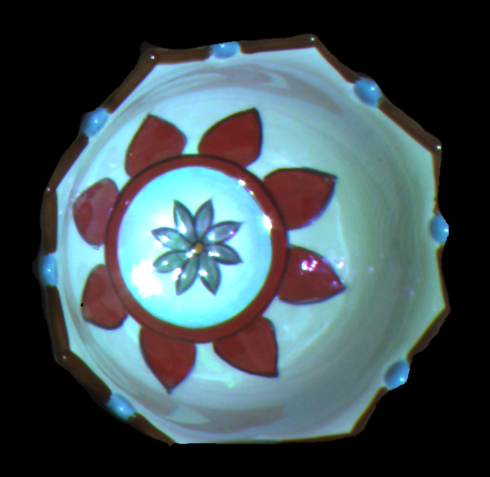
Phase Shifting and Interreflections
point
interreflections
projector
Concave Bowl

Slide 11
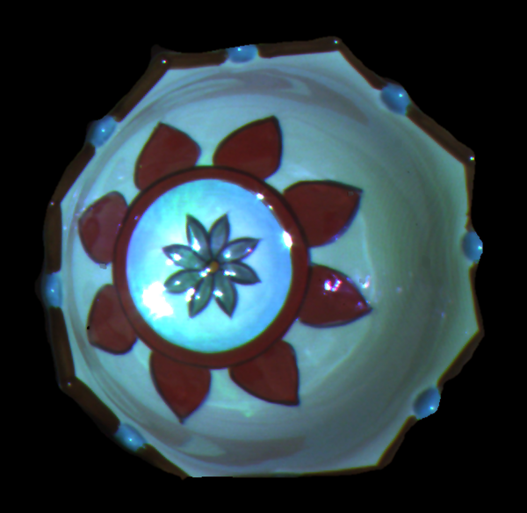
Phase Shifting and Interreflections
Errors due to interreflections
Concave Bowl
Reconstructed Shape

Slide 12


Phase Shifting and Interreflections
camera
p
interreflection
P
$$×$$
$i_{p}$ =
illumination pattern
Q
R
scene
projector
light transport coefficients
Notes:
Cite Shree’s paper here.
Global illumination invariant.
Captured image is a dot product between the light-transport coefficients and illumination. In frequency domain, it is a multiplication. In natural scenes, the frequency response of light transport falls. If illumination is high-frequency, then the contribution due to global illumination is zeroed out, or becomes constant. This is a nice and easy explanation.

Slide 13
Phase Shifting and Interreflections
camera
p
interreflection
P
$$×$$
$i_{p}$ =
illumination pattern
Q
R
scene
projector
light transport coefficients
Notes:
Cite Shree’s paper here.
Global illumination invariant.
Captured image is a dot product between the light-transport coefficients and illumination. In frequency domain, it is a multiplication. In natural scenes, the frequency response of light transport falls. If illumination is high-frequency, then the contribution due to global illumination is zeroed out, or becomes constant. This is a nice and easy explanation.

Slide 14
Phase Shifting and Interreflections
camera
p
interreflection
illumination pattern
light transport coefficients
P
$i_{p}$ =
*
Q
pixels
pixels
R
scene
projector
Notes:
Cite Shree’s paper here.
Global illumination invariant.
Captured image is a dot product between the light-transport coefficients and illumination. In frequency domain, it is a multiplication. In natural scenes, the frequency response of light transport falls. If illumination is high-frequency, then the contribution due to global illumination is zeroed out, or becomes constant. This is a nice and easy explanation.

Slide 15

Phase Shifting and Interreflections
illumination pattern
light transport coefficients
interreflection
$i_{p}$ =
*
pixels
pixels
Notes:
Cite Shree’s paper here.
Global illumination invariant.
Captured image is a dot product between the light-transport coefficients and illumination. In frequency domain, it is a multiplication. In natural scenes, the frequency response of light transport falls. If illumination is high-frequency, then the contribution due to global illumination is zeroed out, or becomes constant. This is a nice and easy explanation.

Slide 16


Phase Shifting and Interreflections
projected patterns
illumination pattern
light transport coefficients
interreflection
$I_{p}$ =
bandlimit
$$×$$
frequency
frequency
Interreflections corrupt phase for low frequency sinusoids

Slide 17
Achieving Invariance to Interreflections
projected patterns
illumination pattern
light transport coefficients
interreflection
high
frequencies
$I_{p}$ =
bandlimit
$$×$$
frequency
frequency
High Frequency Illumination Invariance to Interreflections

Slide 18
Phase Shifting: Issues
Interreflections
Defocus
camera
defocus blur
scene
projector
scene
P
Q
interreflections
projected image
received image
blurred
projector
Notes:
Now, let’s take the same scene and illuminate it with a limited depth of field device, such as a projector. For example this projector here. Projectors are designed to project a focused image on a single flat screen. However, if the projector focal plane is not on the scene, the image will be blurred or defocused. This is called defocused illumination.
Now these are two completely different physical effects – global illumination is an intrinsic property of the scene, and depends on material properties and scene geometry. On the other hand, defocused illumination is a property of the illumination device. So, one is a property of the scene, the other a property of illumination. Then why is it that we are interested in studying them together?

Slide 19
Phase Shifting and Defocus
projected patterns
ideal
irradiance profile
projector
defocus kernel
actual
irradiance profile
*
=
time
time
time
Notes:
So far, we have talked about global illumination. There is another optical effect which is a problem – defocus. Now briefly discuss defocus.

Slide 20

Phase Shifting and Defocus
projected patterns
ideal
irradiance profile
projector
defocus kernel
actual
irradiance profile
$$×$$
=
frequency
frequency
frequency
Notes:
So far, we have talked about global illumination. There is another optical effect which is a problem – defocus. Now briefly discuss defocus.

Slide 21
Phase Shifting and Defocus
projected patterns
ideal
irradiance profile
projector
defocus kernel
actual
irradiance profile
$$×$$
=
frequency
frequency
frequency
projected patterns
ideal
irradiance profile
projector
defocus kernel
actual
irradiance profile
=
$$×$$
frequency
frequency
frequency
Large Number of Unknowns
Notes:
So far, we have talked about global illumination. There is another optical effect which is a problem – defocus. Now briefly discuss defocus.
Amplitude is one of the unknown of the sinusoid.

Slide 22


Achieving Invariance to Defocus
projected patterns
ideal
irradiance profile
projector
defocus kernel
actual
irradiance profile
=
Similar amplitudes
$$×$$
Narrow
Band
frequency
frequency
frequency
projected patterns
ideal
irradiance profile
projector
defocus kernel
actual
irradiance profile
$$×$$
=
Narrow
Band
Similar amplitudes
frequency
frequency
frequency
Narrow Frequency Band Invariance to Defocus
Notes:
Invariance to defocus is simpler – since the effect of defocus is a function of frequency, we can make it nearly invariant by projecting frequencies that are very close to each other.
Make slides 19-24 nicer, more consistent. One way versus both ways of the frequency plots. Can I make these slides look nicer, more illustrative, more consistent?

Slide 23


Micro Phase Shifting
ω_{max}
ω_{mean}
ω_{min}
Narrow,
High-Frequency Band
amplitude
frequency (ω)
Notes:
Why is it called micro? Show the micro range, and show the micro periods.
Using these two invariants, we propose a new phase shifting technique called Micro Phase Shifting. Define it. All the frequencies are chosen to be in a narrow high-frequency band. The width is chosen to be narrow enough…
Might have to show the frequency plot on both sides.

Slide 24
Invariance to Interreflections
ω_{max}
ω_{mean}
ω_{min}
High Mean Frequency
(ω_{mean})
amplitude
light-transport
bandlimit
frequency (ω)
Notes:
Show light transport bandwidth here.
The mean frequency is chosen to be high enough so that the captured images are resistant to global illumination.

Slide 25
Invariance to Defocus
ω_{max}
ω_{mean}
ω_{min}
Narrow
Bandwidth (δ)
amplitude
Similar amplitudes
frequency (ω)
Notes:
Show the defocus kernel here. And show the attenuation.
The key idea is to project patterns limited to a narrow, high frequency band.

Slide 26
How to Disambiguate Phase?
ω_{max}
ω_{mean}
ω_{min}
How Can We Disambiguate Phase
Without Low Frequency Patterns?
Notes:
Show the defocus kernel here. And show the attenuation.
The key idea is to project patterns limited to a narrow, high frequency band.

Slide 27
How to Disambiguate Phase?
49Hz.
51Hz.
+
ω₁
ω₂ = ω₁ + 2δ
1Hz.
Beat Frequency = δ
Notes:
Let’s look at the problem in 1D.
Suppose we have two high frequencies. It turns out that if the frequencies are very close to each other, their combination can emulate a low frequency. <Nice graphic>
This is called beat frequency, and is frequently encountered in acoustics and music.
In particular, if the frequencies are f1 and f1+delta, the resulting frequency is delta/2. For example, if f1 is 49Hz., and f2 is 51Hz., the beat frequency is a very low 1Hz.

Slide 28





Phase Disambiguation: Number Theory
$$period: p pixels$$
$$phase: q pixels$$
$$correspondence: C pixels$$
$$C =n p+q$$
number of periods (unknown)
Notes:
There is another, more formal way of looking at this problem.
Consider this…
This is a combinatorial problem. How can we solve this? Give more intuition as to why is this hard?
<<Change the correspondence color to red everywhere. Make colors consistent. >>

Slide 29



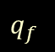

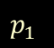


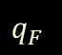



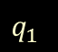
Phase Unwrapping: Micro Phase Shifting
$$p_{1}$$
$$q_{1}$$
$$p_{f}$$
$$q_{f}$$
$$p_{F}$$
$$q_{F}$$
$$C$$
$$C$$
$$C$$
$$C= n_{1}p_{1}+q_{1}$$
$$C= n_{f}p_{f}+q_{f}$$
$$C= n_{F}p_{F}+q_{F}$$
unknown
known
unknown
known
unknown
known
Solve System of Simultaneous Congruences
Notes:
These are combinatorial / integral equations.
This just says that if C is divided by p, it leaves a remainder of q.
This is a combinatorial problem. How can we solve this? Give more intuition as to why is this hard?
<<Change the correspondence color to red everywhere. Make colors consistent. >>

Slide 30
Chinese Remainder Theorem
$$C= n_{1}p_{1}+q_{1}$$
$$C= n_{f}p_{f}+q_{f}$$
$$C= n_{F}p_{F}+q_{F}$$
Theorem:
There exists an integer C solving the above system of simultaneous congruences, if p₁ ,…, p_{f} ,…, p_{F} are positive integers which are pairwise coprime.
[The Mathematical Classic by Sun Zi, 3rd century AD]
Efficient Algorithms Available for Solving
Notes:
This is a well-studied problem in number theory.
There is a result called the Chinese remainder theorem which says that a solution exists to this set of congruences, if the periods are pairwise coprime. It is called Chinese remainder theorem because it deals with remainders and was first proposed by a Chinese mathematician in 3rd century AD.
Later, an algorithm to find the solution was described by Aryabhata, an Indian mathematician, in 6th century. Derivation and the algorithm can be found in almost any contemporary number theory book.
This theorem finds wide uses in cryptography, polynomial interpolation, and fast fourier transform.
One very related application is in interferometry…
Say something about linear time algorithm.

Slide 31






How Many Frequencies Are Required?
$$p_{1}$$
$$p_{F}$$
$$p$$
$$C$$
$$C$$
$$Number of columns: N$$
periods of projected frequencies
period of emulated low frequency
$$p_{1}×⋯×p_{F}=p$$
$$p≥N$$
$$\text{Condition} \text{for} \text{unambiguous} \text{phase} \text{recovery}\text{:}$$
Two Frequencies are Necessary
Notes:
So, how many high-frequencies do we need?
The period of the emulated low frequency is the product of the periods of all the high-frequencies.
Show the formula.
For recovering the phase unambiguously, at least one of the periods – either original, or emulated, should be greater than the number of projector columns.
Since none of the original frequencies have a large period, one frequency is not sufficient. At least two are required.

Slide 32
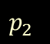
How Many Frequencies Are Required?
$$p_{1}$$
$$p_{2}$$
$$p$$
$$C$$
$$C$$
$$Number of columns: N$$
$$p_{1}× p_{2}≥N$$
$$\text{Choose} \text{two} \text{frequencies} \text{so} \text{that}$$
Two Frequencies are Sufficient
Notes:
If we choose the frequencies so that the product of the periods is greater than the number of columns, two are sufficient as well.
So, with only two high-frequencies, we can recover unambiguous phase.

Slide 33

How Many Images Are Required?
offset
(interreflections)
amplitude
(defocus)
phase
$$I_{k}^{i} = g + a\cos\left(∅^{i}+ \frac{2πk}{K}\right)$$
radiance for
k^{th} shift of ω_{i}
number of shifts
F = number of frequencies
Number of Unknowns = F+2
Notes:
A practitioner might ask – frequencies are fine, but tell me what is the number of images required?
Let’s look at the image formation model for this.
Number of unknowns becomes F+2 – a function of the number of frequencies. With F+2 equations, this system of equations can be solved jointly. We show in the paper that the minimum number of unknowns is F+2 – so this algorithm is theoretically optimal in terms of the number of measurements. Proof and details of the algorithm are in the paper.
Because this is a linear system, the number of images is equal to the number of unknowns.
Since the minimum F is 2, the minimum number of images required is four.
So, with only four images, micro phase shifting makes it possible to recover unambiguous shape.

Slide 34
How Many Images Are Required?
offset
(interreflections)
amplitude
(defocus)
phase
$$I_{k}^{i} = g + a\cos\left(∅^{i}+ \frac{2πk}{K}\right)$$
radiance for
k^{th} shift of ω_{i}
number of shifts
Four Images are Sufficient
Notes:
A practitioner might ask – frequencies are fine, but tell me what is the number of images required?
Let’s look at the image formation model for this.
Number of unknowns becomes F+2 – a function of the number of frequencies. With F+2 equations, this system of equations can be solved jointly. We show in the paper that the minimum number of unknowns is F+2 – so this algorithm is theoretically optimal in terms of the number of measurements. Proof and details of the algorithm are in the paper.
Because this is a linear system, the number of images is equal to the number of unknowns.
Since the minimum F is 2, the minimum number of images required is four.
So, with only four images, micro phase shifting makes it possible to recover unambiguous shape.

Slide 35






Conventional vs. Micro Phase Shifting
Conventional Phase Shifting: Three Images
Micro Phase Shifting: Four Images
Notes:
Conventional phase shifting requires at least three images. With only one extra image, micro phase shifting provides invariance to both interreflections and defocus. Of course, 4 is the theoretical minimum. To account for noise and finite projector resolution, more can be acquired.

Slide 36

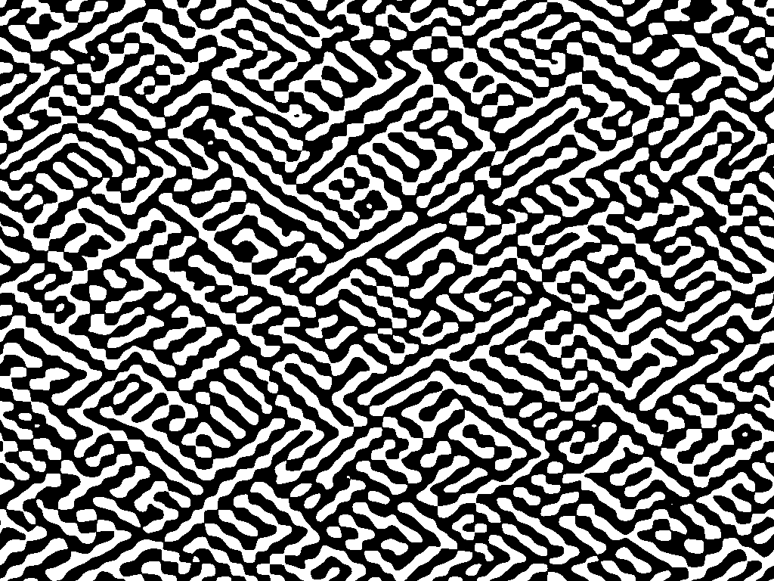



Current State-of-the-Art
Binary patterns
[Gupta et al., 2011]
[Couture et al., 2011]
[Xu and Aliaga, 2009]
42 images
200 images
400-1600 images
Modulated Phase Shifting
x
=
[Gu et al., 2011] [Chen et al., 2008]
Low SNR. 7+ images.
Notes:
Before we go on to results, I will briefly discuss the current techniques which handle these two problems.

Slide 37
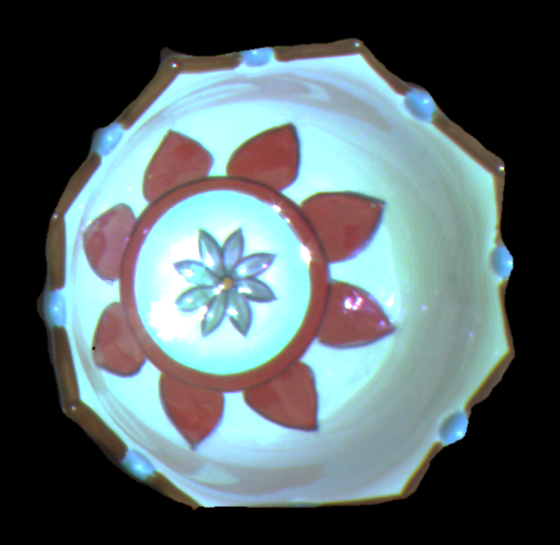
Ceramic Bowl: Interreflections
Notes:
This is a ceramic bowl. There are strong interreflections inside the bowl.

Slide 38


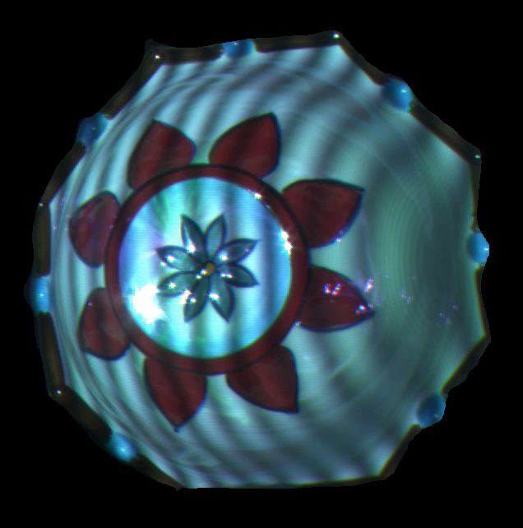
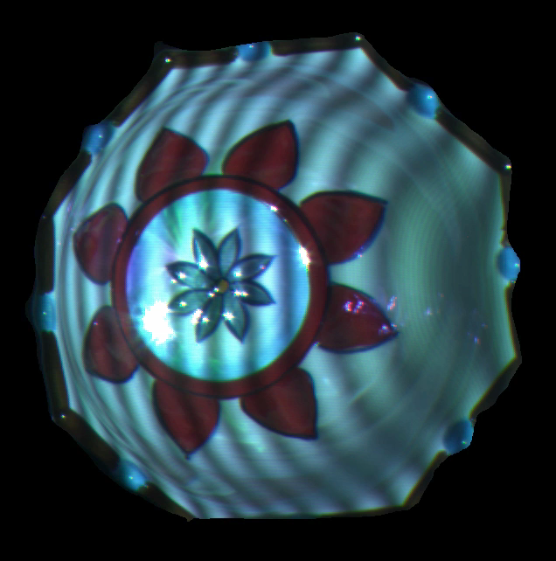
Projected and Input Images
Projected
Input
Conventional Phase Shifting
[7 images, 2 Frequencies]
Modulated Phase Shifting
[7 images, 1 Frequency]
Micro Phase Shifting [Our]
[7 images, 5 Frequencies]
Notes:
Replace modulated images.
Show input images for modulated phase shifting as well.
First, we consider interreflections.

Slide 39
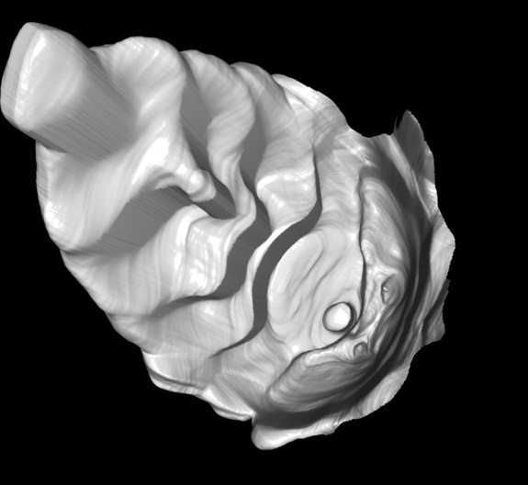
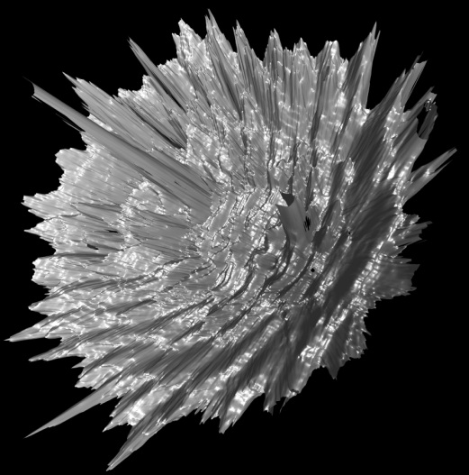
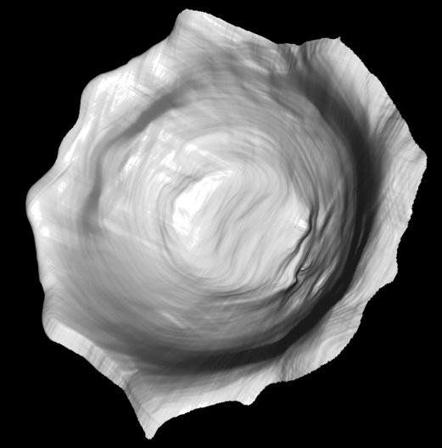
Shape Comparison (seven input images)
Conventional Phase Shifting
Modulated Phase Shifting
[Gu et al.]
Micro Phase Shifting
[Our]
Notes:
Citations, our method.
With only 7 input images, Micro phase shifting produces a high quality reconstruction.

Slide 40
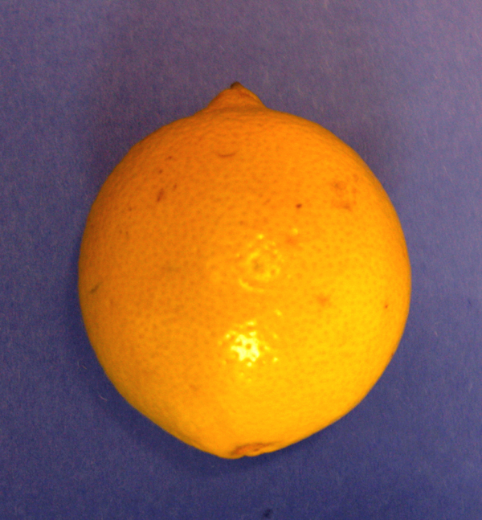
Lemon: Subsurface Scattering
subsurface scacttering
point
projector
Notes:
This is a lemon. Lemon skin is translucent, resulting in sub-surface scattering.

Slide 41
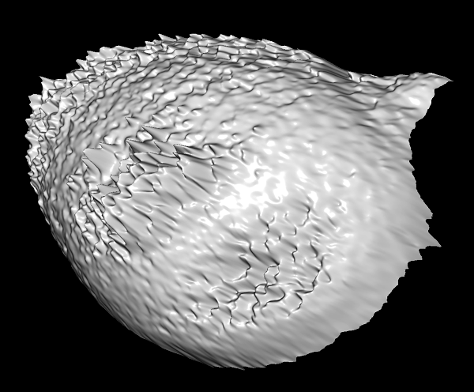
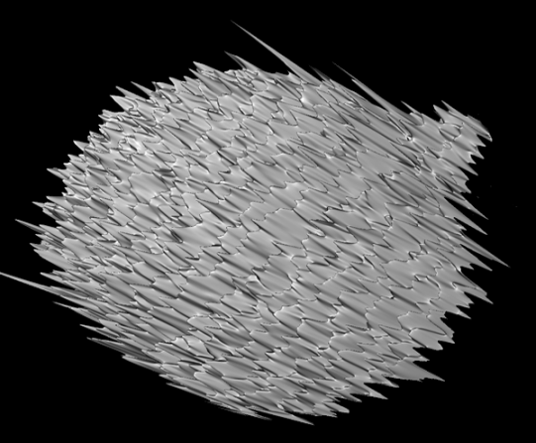
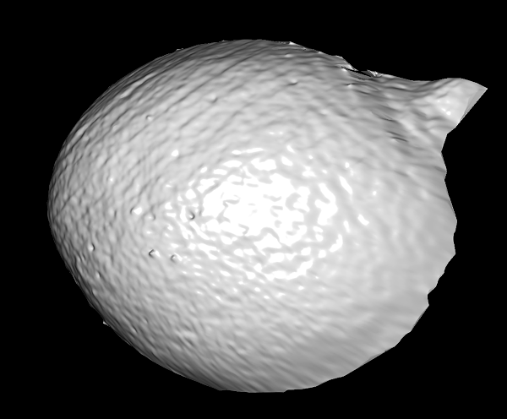
Shape Comparison (seven input images)
Conventional Phase Shifting
Modulated Phase Shifting
[Gu et al.]
Micro Phase Shifting
[Our]
Notes:
Here is a comparison of the recovered shapes using 7 input images.

Slide 42

Russian Dolls: Defocus
Notes:
This is a bunch of Russian dolls.

Slide 43
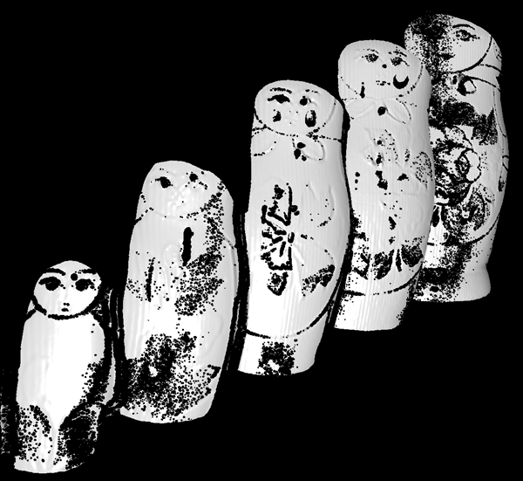
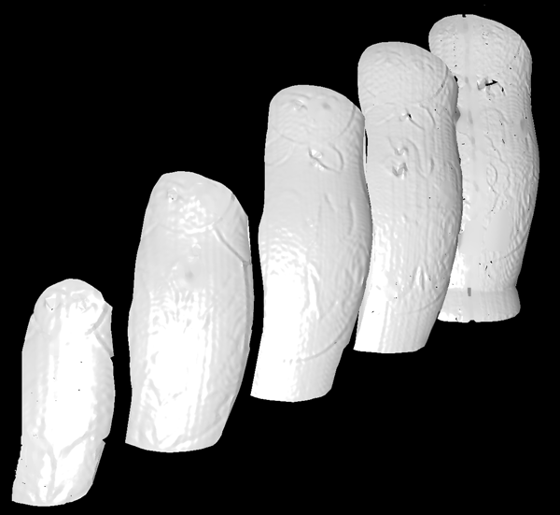
Shape Comparison (seven input images)
Holes in low albedo regions
Conventional Phase Shifting
Micro Phase Shifting [Our]
Notes:
Shapes recovered using both conventional and modulated phase shifting have holes in regions with low albedo. Conventional techniques need to capture a large number of images to account for the effects of defocus.
In contrast, given a budget of 7 images, Micro phase shifting can capture 5 different frequencies. This helps recovering shape reliably even in low light and high noise conditions.

Slide 44
Wax Bowl: Interreflections + Scattering
Notes:
This is a wax bowl. This is a challenging scene because it has both interreflections and strong subsurface scattering.

Slide 45
Shape Comparison (seven input images)
Conventional Phase Shifting
Modulated Phase Shifting
[Gu et al.]
Micro Phase Shifting
[Our]
Notes:
Shape reconstructed using conventional phase shifting has large errors due to interreflections.
Modulated phase shifting relies on explicitly separating the direct component. Due to low direct component for translucent materials, the shape is extremely noisy.
With only 7 input images, micro phase shifting achieves a high quality reconstruction.

Slide 46
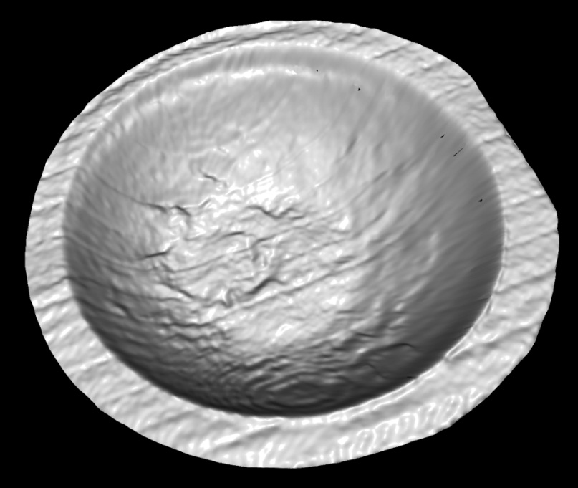
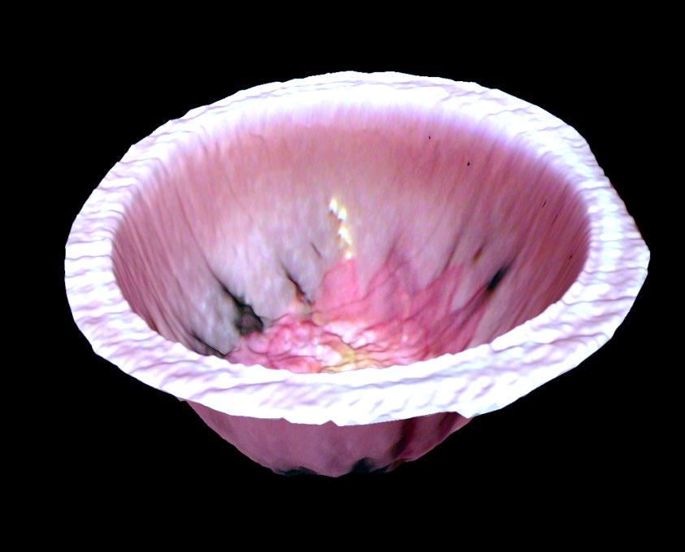
Recovered Shape: Micro Phase Shifting

Slide 47
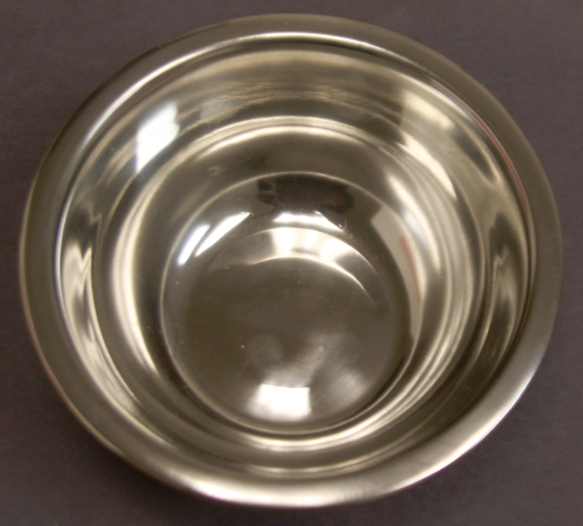
Failure Case: Shiny Metal Bowl
Specular interreflections
Notes:
This is a shiny metal bowl. There are high-frequency specular interreflections inside the bowl.

Slide 48
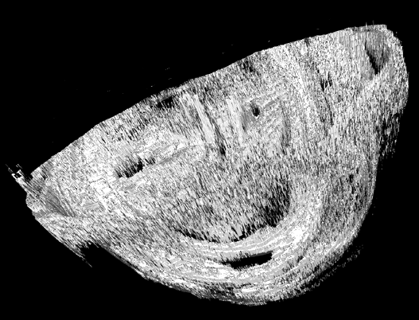
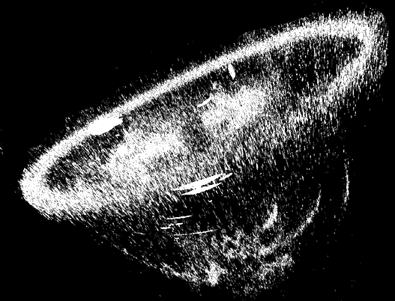
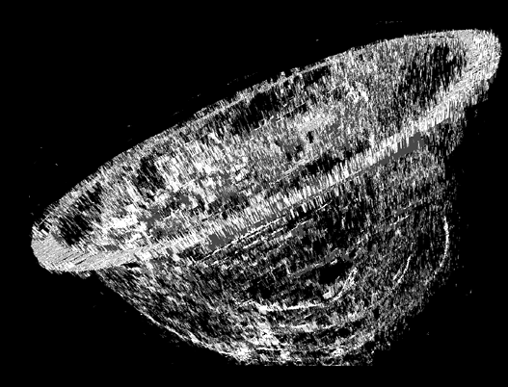
Shape Comparison
Conventional Phase Shifting
Modulated Phase Shifting
[Gu et al.]
Micro Phase Shifting
[Our]
Notes:
In this case, the light transport in the scene is not low frequency. As a result, shapes reconstructed using all the techniques have large holes and errors.

Slide 49
Discussion: Frequency Selection
light transport bandwidth
defocus
kernel
projected
frequency
frequency
frequency
Invariance to interreflections
Amplitude attenuation
projector
resolution
defocus
kernel
similar amplitudes
frequency
frequency
Invariance to defocus
Not resolvable by projector
Notes:
Let’s talk about how we select our frequencies.
Higher are better, but there is a problem too. So, there is a tradeoff.
Similarly, while choosing the bandwidth, narrow is better, but there is a problem too.
So, there are these tradeoffs.
To handle the first tradeoff optimally, we need to know the light transport characteristics of the scene a priori, which may or may not be available. The second one is accounted for in our frequency selection algorithm. More details and code are in the paper and on the project webpage.

Slide 50







Summary: Micro Phase Shifting
Narrow,
High-Frequency Band
amplitude
frequency (ω)
Patterns in Narrow High-Frequency Band
Shape Recovery with Interreflections and Defocus
Notes:
With only a small number of images, Micro phase shifting makes it possible to recover the structure of complex scenes that are traditionally considered hard.
For high resolution results, please look at the attached powerpoint file.
For further details, please refer to the paper and the supplementary technical reports.

